Slide 1
Adding event to DOM Nodes
Events:
Events are actions that respond to user’s specific actions.
Events are controlled in JavaScript using event handlers that indicate what actions the browser takes in response to an event.
Event handlers are created as attributes added to the HTML tags in which the event is triggered.
An Event handler adopts the event name and appends the word "on" in front of it.
< tag onEvent = "JavaScript commands;">
Thus the "click" event becomes the onClick event handler

Slide 2
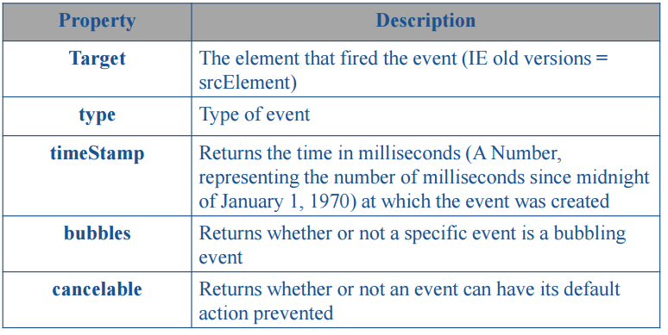
Event properties

Slide 3
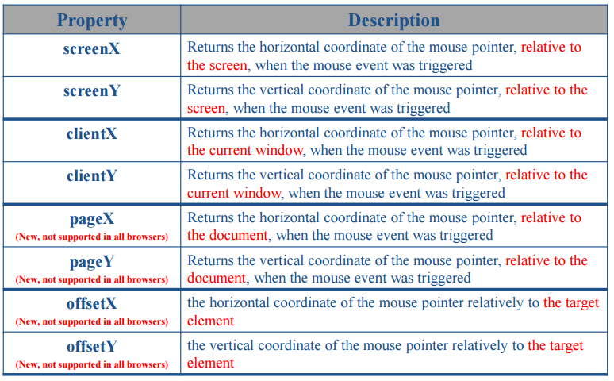
Event properties

Slide 4
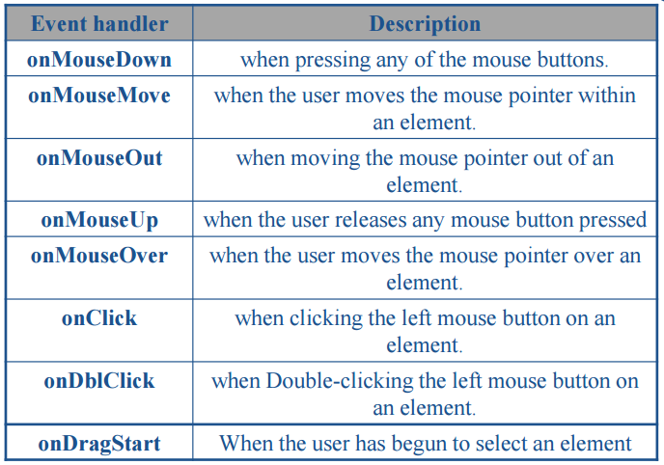
Mouse Events

Slide 5
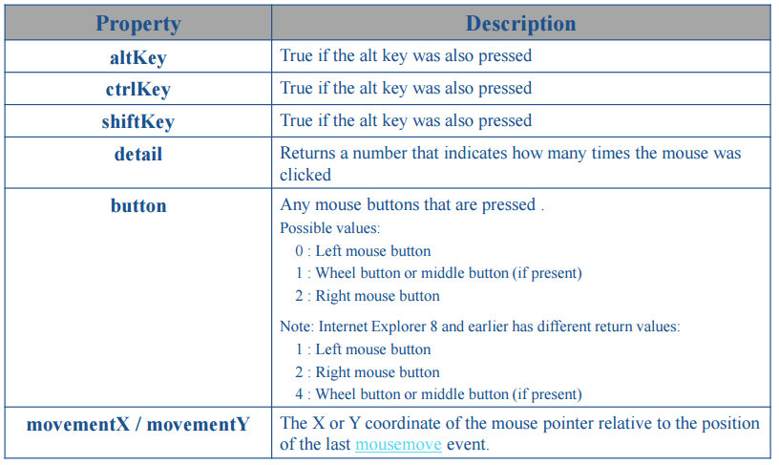
MouseEvent object properties

Slide 6
Adding event to DOM Nodes
The addEventListener() method attaches an event handler to the specified element.
The addEventListener() method attaches an event handler to an element without overwriting existing event handlers.
You can add many event handlers to one element.
You can add many event handlers of the same type to one element, i.e tw"click" events.
You can add event listeners to any DOM object not only HTML elements. i.e the window object.
The addEventListener() method makes it easier to control how the event reacts to bubbling.
When using the addEventListener() method, the JavaScript is separated from the HTML markup, for better readability and allows you to add event listeners even when you dnot control the HTML markup.

Slide 7
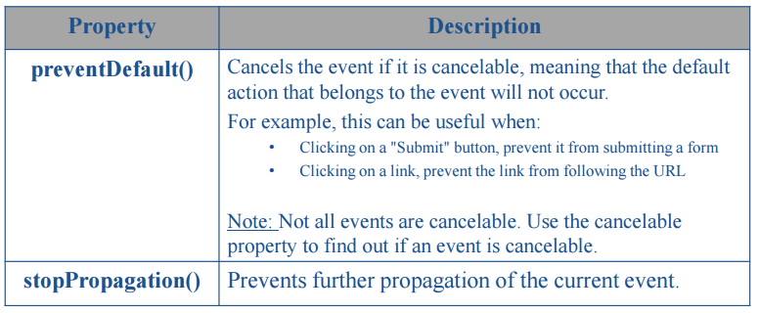
Event object methods

Slide 8
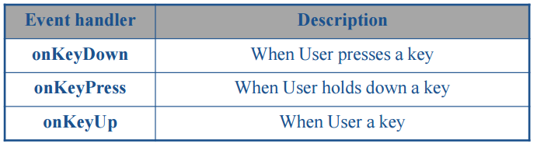
Keyboard Events

Slide 9
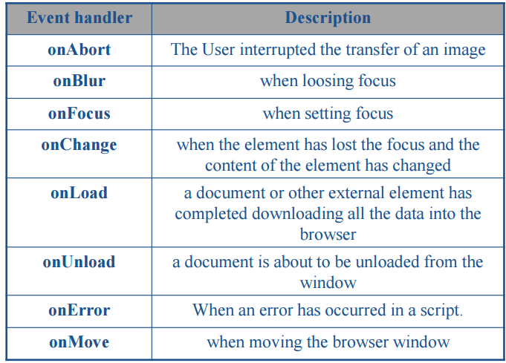
Other Events

Slide 10
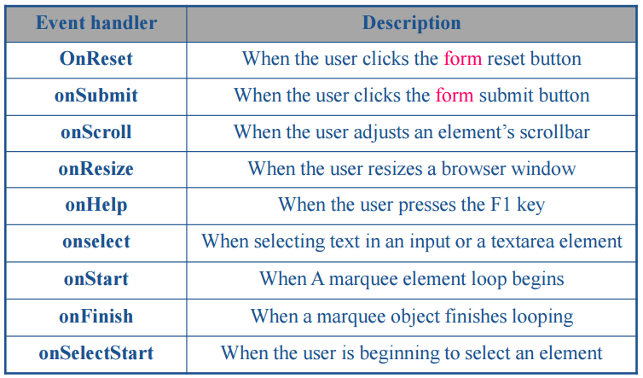
Other Events

Slide 11
XML vs JSON
XML
JSON

Slide 12
client-server architecture
request
client side
server side
response

Slide 13
client-server architecture
request
query
response
resualt
database server
client side
server side

Slide 14
JSON Syntax vs. XML Syntax
<students>
<student id=’1001’>
<name>ALi</name>
<age>20</age>
<courses>php,js</courses>
<address>
<city>Alex</city> <street>19 jun.</street>
</address>
</student>
<student id=’1002’>
<name>Soha</name>
<age>27</age>
<courses>c#,js,java</courses>
<address>
<city>Sohag</city>
<street>Tahrir.</street>
</address>
</student>
</students>

Slide 15
What is JSON
Stands for (JavaScript Object Notation).
It is a lightweight data-interchange format.
It is not a markup language, not scripting or programming language.
JSON uses JavaScript syntax, but the JSON format is text only, just like XML.Text can be read and used as a data format by any programming language.
Text-based.
It can be used instead of XML.
It is a special object notational construct, that is a subset of JavaScript.
It is a text format that is completely language independent but uses conventions that are familiar to programmers of the C-family of languages.

Slide 16
JSON feature
lightweight data-interchange format.
Easy for humans to read and write.
JSON is "self-describing" and easy to understand.
Easy for machines to parse and generate.
JSON Supports a lot of programming languages such as:
ActionScript, C, C#, ColdFusion, E, Java, JavaScript, ML,
Objective CAML, Perl, PHP, Python, Rebol, Ruby, and
Lua.
It has support for Unicode, allowing almost any information in any human language tbe communicated.

Slide 17
JSON structure
JSON is built on tow structures:
A collection of name:value pairs, separated by (:). Name is string, value is one of JSON values.
(Ex.: "Name" : "Ahmed").
An ordered list of values. In most languages, this is realized as an array, vector, list, or sequence.
(Ex.: "courses": [ "HTML","CSS","PHP"] )

Slide 18
JSON values format
JSON supports these basic data types:
Strings (in double quotes)
Numbers (integer or floating point)
Booleans (true, false).
Objects (in curly braces)
Arrays (in square brackets)
null

Slide 19
JSON vs XML
Much Like XML:
Both JSON and XML is plain text
Both JSON and XML is "self-describing" (human readable)
Both JSON and XML is hierarchical (values within values)
Both JSON and XML can be fetched with an HttpRequest
Much Unlike XML:
JSON doesn't use tags
JSON is shorter
JSON is quicker to read and write
JSON can use arrays
The biggest difference: XML has tbe parsed with an XML
parser, JSON can be parsed by a standard JavaScript function.

Slide 20
Why JSON over XML?
Why JSON over XML?
Lighter and faster than XML as on the wire data format.
JSON objects are typed while XML data is typeless.
- JSON types: string, number, array, boolean, object.
- XML data: are all string
Native data form for JavaScript code
- Data is readily accessible as JSON objects in your JavaScript Code vs. XML data needed to be parsed and assigned to variables.
- Retrieving values is as easy as reading from an object property in your JavaScript code

Slide 21
JSON Syntax vs. XML Syntax
{ "sdfStudents": [
{ "id":1001 ,
"name":"ALi" ,
"age":20 ,
"courses": [ "php" , "js" ] ,
"address": { "city": "Alex" ,
"street": "19 jun."
}
} ,
{ "id":1002 ,
"name":"Soha" ,
"age":27 ,
"courses": [ "c#" , "js","java" ] ,
"address": { "city": "Sohag" ,
"street": "Tahrir"
}
}
]
}

Slide 22
How to read JSON files from the server?
The file type for JSON files is ".json" (or even .txt files), it’s
just text files.
JSON Http Request: A common use of JSON is to read data
from a web server, and display the data in a web page is using Http Request (XMLHttpRequest Object).
Http Request is alsa technique used in Ajax.

Slide 23
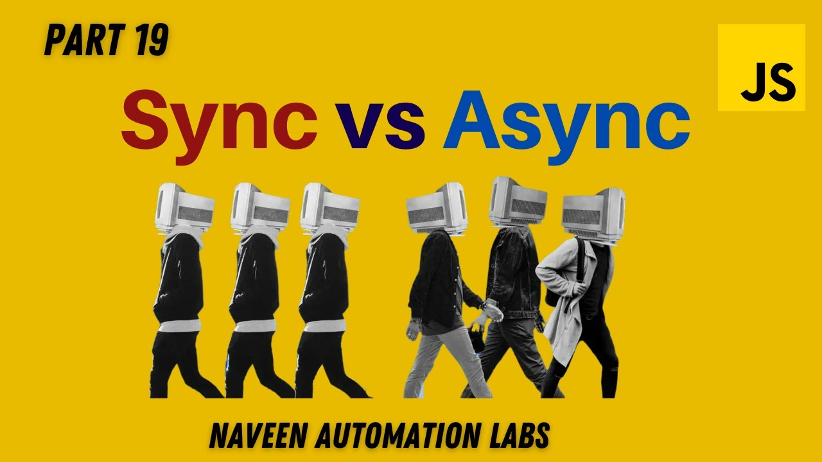
Sync vs Async
Synchronous
Asynchronous

Slide 24
What is AJAX?
AJAX stands for Asynchronous JavaScript And XML.
AJAX is a technique for creating "better, faster, more responsive web applications".
AJAX allows web pages to be updated asynchronously by exchanging small amounts of data with the server behind the scenes. This means that it is possible to update parts of a web page, without reloading the whole page.
Classic web pages, (which do not use AJAX) must reload the entire page if the content should change.
Examples of applications using AJAX: Google Maps,Gmail, Youtube, and Facebook tabs.

Slide 25
The XMLHttpRequest object
The XMLHttpRequest object is used to exchange data with a server.
It is an object (a constructor function) that allows you to send HTTP requests from JavaScript.
supported by virtually all modern browsers, including IE 5+ , Firefox and Opera, and it is supported on a wide range of platforms, including Microsoft Windows, UNIX/Linux, and MacOS X. Used in Ajax, and tget files and data from the server.

Slide 26
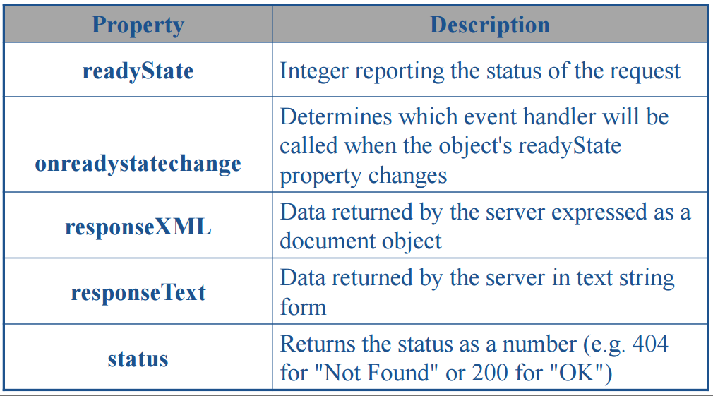
The XMLHttpRequest object - propeties

Slide 27
readyState property values
Name | Description
0 | The XMLHttpRequest client has been created, but the open() method hasn't been called yet.
1 | server connection has been established and open() method has been called.
2 | send() has been called.
3 | Loading : Response's body is being received.
4 | The operation is complete

Slide 28
The XMLHttpRequest object
HTTP error types (Status):
• 1xx Informational
• 2xx Success
• 3xx Redirection
• 4xx Client Error
• 5xx Server Error
Status & Status Text:
• 404: Not found :The server found nothing matching the URI given.
• 200: OK : The server successfully returned the page
• 400: Bad Request : Server didn’t understand the request due to unformed syntax.
• 401: Unauthorized : The request requires user authentication.
• 500: Internal Server Error : The server encountered an unexpected error and couldn’t fulfill the request.
• 503: Service Unavailable : The server is currently unable to handle the request due to temporary overloading or maintenance.

Slide 29
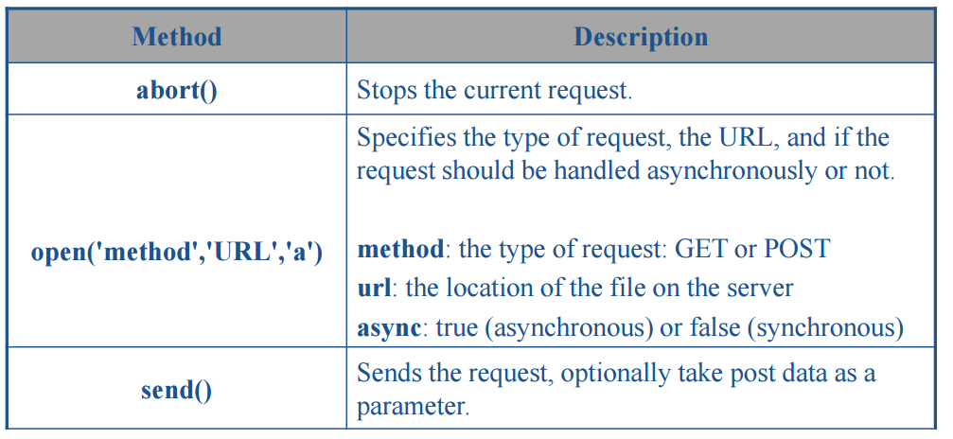
The XMLHttpRequest object - mothods

Slide 30
The XMLHttpRequest object
Steps for communication with the server using XMLHTTPRequest:
Creating XMLHTTPRequest (XHR) object.
Initialize the object (using open() method).
Send the request (Using send() method).
Monitoring the state of the request.
Dealing with the server response.

Slide 31
ADDITIONAL RESOURCES
V8 engine and execution of code : https://blog.sessionstack.com/how-does-javascript-actually-work-part-1-b0bacc073cf
Event loop video: https://www.youtube.com/watch?v=8aGhZQkoFbQ
https://blog.logrocket.com/deep-dive-into-event-bubbling-and-capturing/

